Slide 1
Capstone Project 2 Retail Sales prediction Data science learners Team Team Members: Ayush Goyal
M Sameer Ahamed
Nitesh Bhowmick

Slide 2
Content
Problem statement
Data summary
Exploratory Data prediction
EDA For a Rossmann sales prediction
Machine Learning
Linear Regression
Decision Tree
Feature Engineering
Challenges
Conclusion

Slide 3
Problem Statement
Prediction based on sales
Prediction based on sales on dependent variable
Prediction based on store type
Prediction based on sales between assortment and store type
Prediction based on state holiday and school holiday
Prediction based on day of week and open promo

Slide 4
Data Summary
In the Rossmann sales prediction project there is a dataset which contains sales information.
There are two dataset that is Rossmann Store dataset and Store dataset.
Rossmann Store dataset has 1017209 rows and 8 columns whereas Store dataset has 1115 rows and 10 columns.
Data contain information on Sales, Customers, Assortments, State Holidays,
School Holidays, Promotions etc.

Slide 5
Exploratory Data Prediction
Exploratory Data Prediction is also known as EDA, is the process of interpreting datasets by summarizing their key properties and frequently them
EDA refers to the critical process of performing initial investigation on datasets so as discover the patterns, to spots anomalies , to hypothesis, and to check assumptions with the help of summary statics and graphical representation
In EDA, plotting option include box plot, line plots , scatter plots and many more.

Slide 6
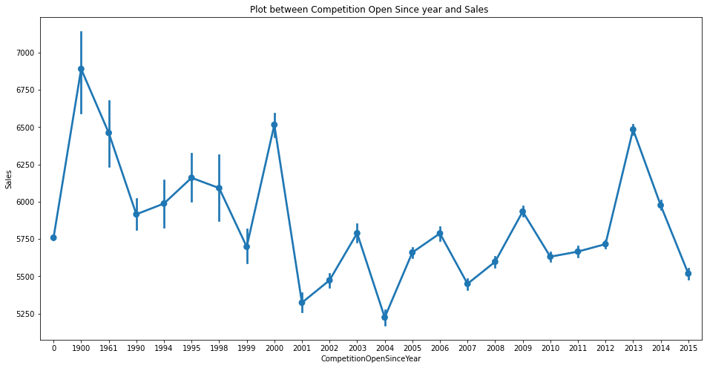
Sales
From the plot we can see sales are high during the year 1900. as there are very few store were operated of Rossmann so there is less competition and sales are high but the pass year no of store increased

Slide 7
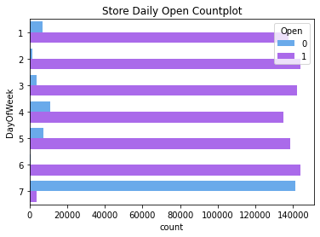
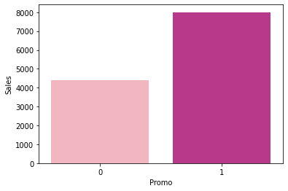
Day of week & open promo
B
Bar plot b/w promo and sales shows the effect of promotion on sales here 0 represents the store which did not opt for promo and 1 shows for stores who opt for promo. Those store who took promotion their sales are high as compared to store who didn’t took promo

Slide 8
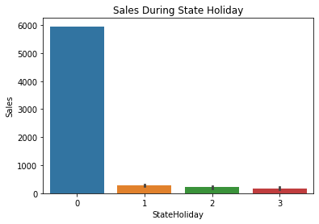
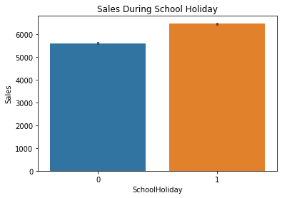
State Holiday & School Holiday
We can observe that most of the store remain closed during state and holiday. but it is interesting to note that the no of store opened during school holiday were more than that were opened during state holiday. Another important thing to note is that the store which were opened during school holiday had more sales than normal.

Slide 9
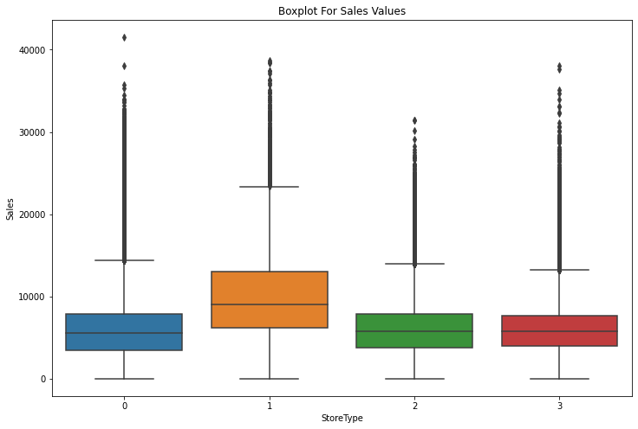
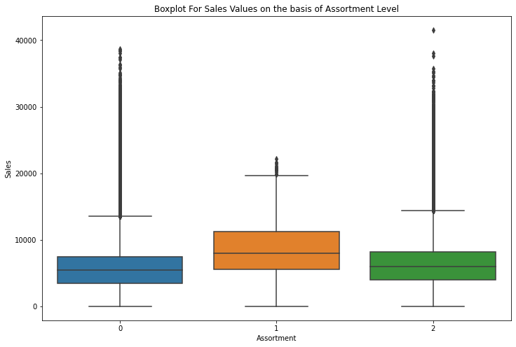
Box plot of sales b/w assortment and store type

Slide 10
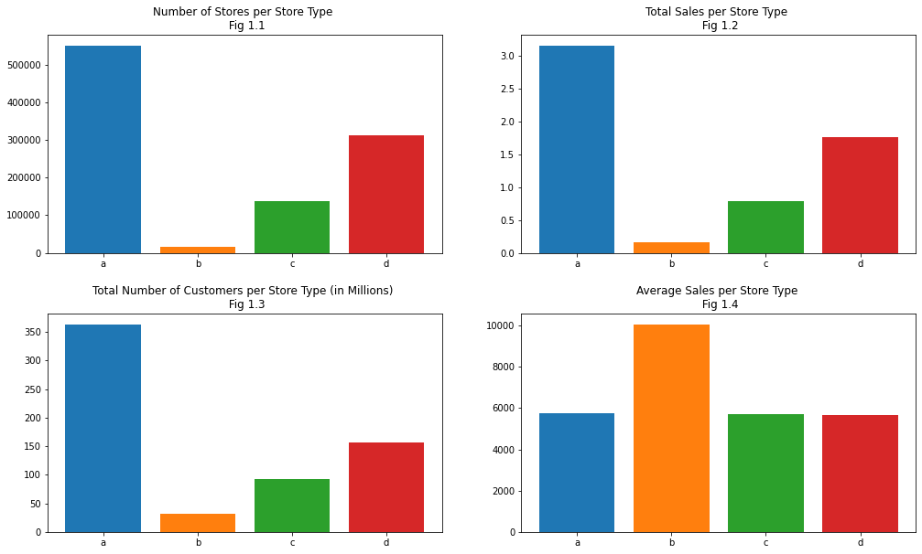
Store Type
We can see Storetype B who was the highest average sales and no of customer

Slide 11
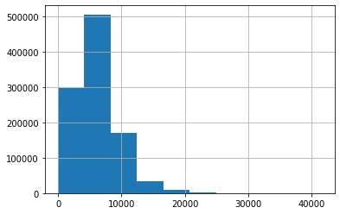
Sales Dependent Variable
N Now checking the number of sales =0

Slide 12
Machine learning
Machine learning is a type of artificial intelligent that allow software application to become more accurate at predicting outcome without being explicitly programmed to do so machine learning algorithms use historical data as input to predict new output value
Machine learning are a common use case for machine learning other popular uses include fraud detection, business process automation (BPA) and predictive maintenance

Slide 13
Why machine learning is important
Machine learning is important because it gives enterprises a view of trends in customers behavior and business operational patterns , as well as supports the development of new products. Many of today leading companies such as Facebook, Google and Uber, make machine learning a central part of their operation. Machine learning has become a significant competitive differentiator for many companies

Slide 14
Different types of machine learning
Supervised learning : In this types of machine learning, data scientists supply algorithms with labeled training data and defined the variables they wants the algorithms to assess for correlation.
Unsupervised learning : This types of machine learning involves algorithms that train on unlabeled data.
Reinforcement learning: It is multi step process for which there are clearly defined rules Data scientist program algorithm complete a task

Slide 15
Linear Regression
Linear Regression is a kind of parametric regression model that makes a prediction by taking the weighted average of the input features of an observation or data point.
Advantage and disadvantage of linear regression:
L Linear regression is a simple to implement , and on other hand in linear regression in difficult
The relationship between the independent variable have a linear relationship, and other hand linear regression also looks at a relationship between the mean of the dependent variable and the independent variables .

Slide 16
Decision tree
Decision Tree is the most powerful and popular tool for Regression and prediction. Decision tree is a flowchart like tree structure, where each internal node denotes a test on a attributes, each branch represents an outcome of the test, and each leaf node(terminal node) holds a class label.
Advantages and disadvantage of the decision tree:
Decision trees are not largely influenced by outliers or missing values, and it can handle both numerical and categorical variables.
One of the limitations of decision tree is that they are largely unstable compared to other decision predictors . A small change in the data can result in a major changes in user will get in a normal event.

Slide 17
Random Forest
Random forest is a Supervised Machine Learning Algorithm that is used widely in Classification and Regression problems. It builds decision trees on different samples and takes their majority vote for classification and average in case of regression.
Advantages and Disadvantages of Random Forest
It is immune to the curse of dimensionality. Since each tree does not consider all the attributes, feature space is reduced.
We don’t have to segregate data into train and test as there will always be 30% of the data which is not seen by the decision tree made out of bootstrap.
Disadvantage
Training time is more compared to other models due to its complexity. Whenever it has to make a prediction each decision tree has to generate output for the given input data.

Slide 18
Ridge Regression
R Ridge regression is a model tuning method that is used to analyze any data that suffers from Multicollinearity . This method performs regularization
Advantage and Disadvantage of Ridge regression:
The biggest benefit of ridge regression is its ability to produce a lower test mean squared error (MSE) compared to its least square regression when multicollinearity is present
The biggest drawback of ridge regression is its inability to perform variable selection since it include all predictor variable in the final model since some predictors will get shrunken very close to zero.

Slide 19
Lasso Regression
Lasso regression is a type of linear regression that uses shrinkage shrinkage is where data value are shrunk towards a central point.
Advantage and Disadvantage of Lasso Regression:
The main advantage of a lasso regression model is that it has the ability to set the coefficient for feature it does not consider interesting to zero and the model does some automatic feature selection on other side biased coefficient that are produced by a lasso model are biased. The L1 penalty that is added to the model artificial shrinks the coefficient closer to zero and difficult to estimate standard errors since the coefficient estimates in a lasso model are biased.

Slide 20
Challenges
Understand the column of the dataset.
Analyze and visualization of the rossmann sales according to feature.
Find the right chart to show the chart.
Difficulties to find out the correct model.

Slide 21
Conclusion
From plot sales and competition open since months show sales go increasing from November and highest in months December.
From plot sales and day of the week sales highest on Monday and start declining from Tuesday to Saturday and o Sunday sales almost near to zero.
Plot b/t promotion and sales show that promotion helps in increasing sales.
Type of store play an important roles in opening pattern of stores.
All Type’b’stores never closed except for refurbishment or other reason.
Assortment level ‘b’ is only offered at store Type ‘b’.
We can observe that most of the stores remain closed during state Holiday. But it is interesting to note that the no of store opened during school holiday.

Slide 22
Q/A

